Slide 1





RÉPUBLIQUE DU SÉNÉGAL
Un Peuple – Un But – Une Foi
WORLD WATER WEEK AT HOME
Virtual session: Join us on the road to Dakar 2021
Where are we at? / How can you be engaged?
Email: secretariat@worldwaterforum9.sn
Website: https://www.worldwaterforum.org
Friday 28 August 2020 13:00-13:45

Slide 2

1- CONTENT DEVELOPMENT

Slide 3
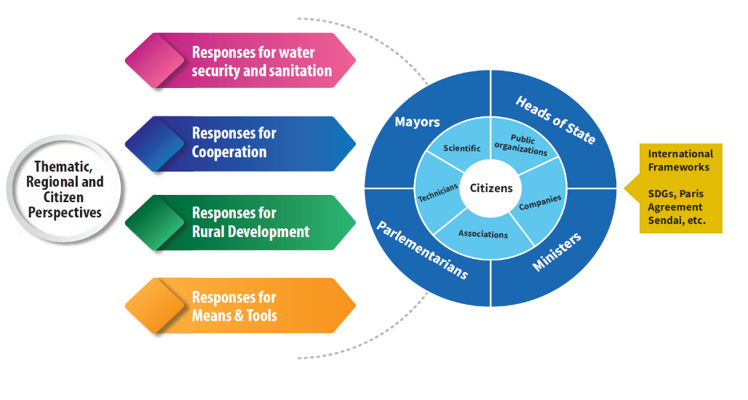



9th World Water Forum STRUCTURE
Four Priorities
led by
Four Pilot Groups
Stakeholders involved
in each Priority
PILOT GROUP
ACTION GROUPS
CONSULTATIVE GROUPS
Project 2
Project 1
Project x
ACTION
Each Action Group will Identify (3 or more) Actions that will contribute to the achievement of the defined objective through the implementation of concrete projects/activities
Linkages : to the SDGs targets to facilitate contributions to global monitoring processes. Collaboration : with the group and others (consultative groups and out of the water box actors).
Notes:
FORUM FRAMEWORK
For this 9th edition of the World Water Forum, it was decided to break with the “business as usual” approach and accelerate action for water. As such, it will not use a siloed approach according to traditional thematic, regional, political and citizens process. It will encourage innovation and greater integration while federating communities.
Indeed, It focuses on an integrated approach based on multi-stakeholder exchanges on a limited number of priorities, enabling the integration the previously siloed perspectives into a fertile cross-cutting exchange.
The 9th Forum’s Framework has been elaborated according to Four Priorities – which are each asked to deliver responses :
Water security and sanitation
Rural Development
Cooperation
Means and tools
The Framework for Action that drives the Forum’s content development was developed based on the desire to create as much coherence as possible with SDG targets both inside and outside of SDG6, so that action that is catalysed through the Forum process can also contribute directly towards the achievement of the SDGs.
This new formula aims at reuniting around the same table mayors, parliamentarians, private and public institutions, academics and NGOs.
The 9th Forum will also put an emphasis on action. As such, it will produce concrete results to accelerate the implementation of international agendas (e.g. SDGs, Paris Agreement, etc.) at all levels.
PRIORITIES STRUCTURE AND TASKS
The Forum’s content development is centered around each of the four priorities. The work within each priority is coordinated by a Pilot Group.
Each priority has 5 or 6 actions groups that have been identified through various consultative processes. Action Groups are constituted around each of these actions. And the Consultative Groups act as a sounding board to the forum content development at the action level.
The action groups are asked to define at least 3 Actions that will contribute to the achievement of the defined objective through the implementation of concrete projects.
These projects or activities can be either something new that the group decided to put together or something already existing, created by one of the member organizations to which action group members decide to contribute to, to scale up or adapt.
The Actions should consist, to the extent possible, of responses to daily challenges faced by the water and sanitation sector.
The related projects should target a wide range of stakeholders, have potential for innovation, replicability and sustainability. They should lend themselves to one or more of the following activities: (a) awareness-raising; (b) capacity development; (c) dialogues; (d) sharing of good practices; (e) partnerships for action; (f) infrastructure/service development, etc.
The collective Actions can have a timeline that goes far beyond the 9th World Water Forum. A certain number of sessions will be developed for the 9th Forum in Dakar to showcase projects that are contributing to reaching the targeted action.
At this particular stage of the process, all Action Groups have submitted to their Pilot Groups all their Actions complete with project proposals
Consultative Groups act as a broader community of practice encompassing a variety of stakeholders. These groups are aligned with each Action Group. They are formed through an open call process and operate on a voluntary basis. In particular, during the period of consultation, they will be solicited to:
Give feedback on the Actions. React to and comment on the different proposals;
Request to collaborate on a particular project or express interest in being actively involved in various activities
Suggest other projects to integrate an Action or propose innovative ideas and additional projects; respond to surveys; etc.
The consultative process should be launched in the following weeks and will take place on the Forum Collaborative Platform
Stakeholders who are interested in contributing to Actions and project can join a consultative group and propose their collaboration.

Slide 4
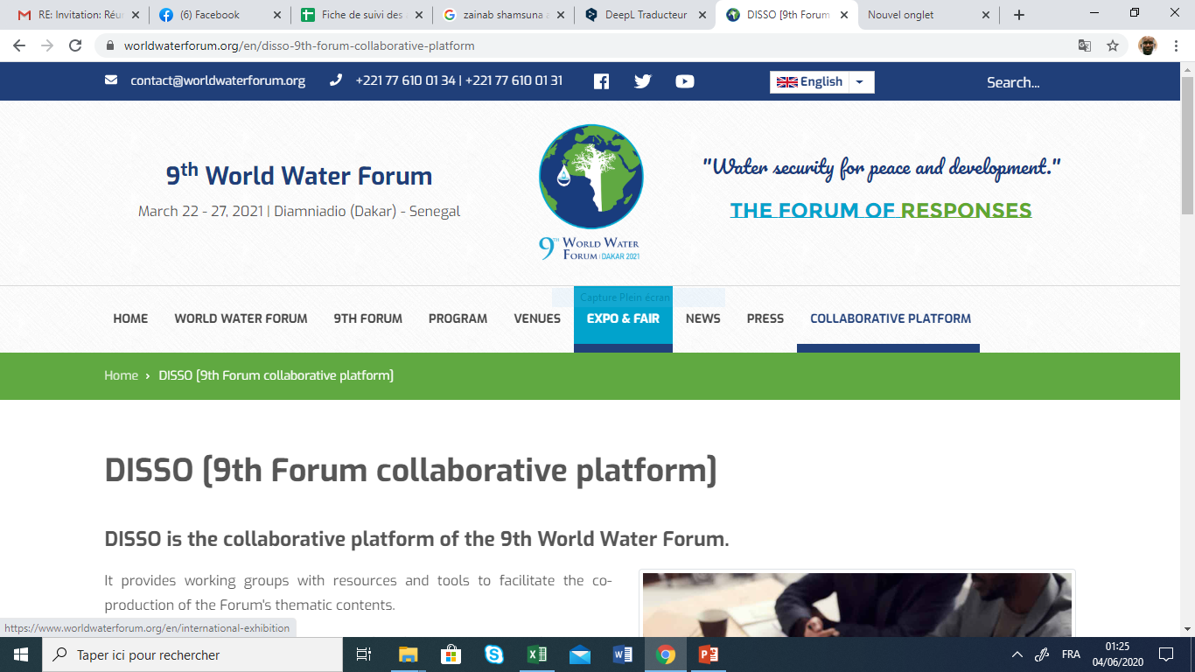
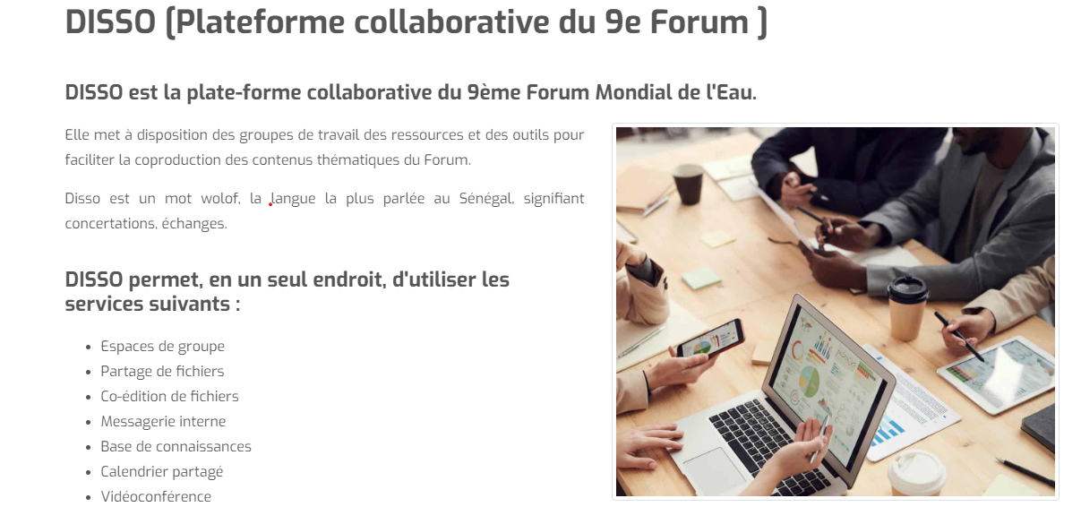
Content Development
Launch of the work of the action groups:
At least 3 actions with different project have been proposed by different actions groups.
The pilot groups examined the first proposals for action and gave their recommendations.
The consultation process will be launched soon and will continue throughout September.
→ Anyone wishing to contribute to the process may apply to join the consultative groups of their interest.
* See the complete Forum Framework at https://www.worldwaterforum.org

Slide 5
2- Mobilization of actors

Slide 6
Mobilization of actors
Institutional Actors
Political actors
Public institutions (states and departments)
Academics and scientists,
Etc.
Ministers
Parliamentarians
Local authorities, etc.
Mobilization of stakeholders
Economic Actors
Civil Society
National and international private sector ;
National and international, bilateral and multilateral donors (banks, etc.)
Pre-Forum
Social and citizen mobilization (young people, women, etc.)
TOGETHER WE MAKE WATER A GLOBAL PRIORITY

Slide 7
Mobilization of actors
International partnership agreements signed with : Switzerland, UNESCO, Korea, OMVS, UNECE, IWRA, France, the Arab Water Council, AMCOW, AFWA, ICESCO, APGMV;
Others are under discussion with some countries and institutions;
Implication in the consultation process and convention with other actors would be an opportunity
to better address the concerns of different regions
to lay the foundations for a fruitful and rich collaboration.

Slide 8
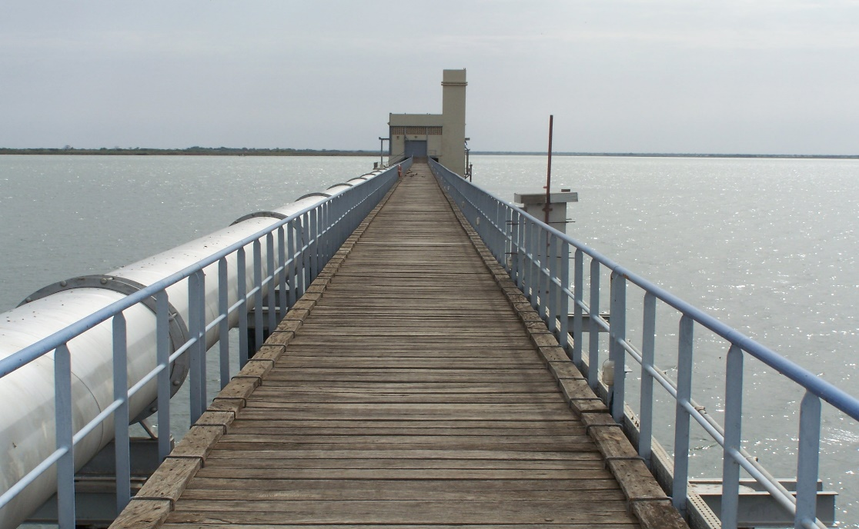
3- Dakar 2021 Initiative

Slide 9
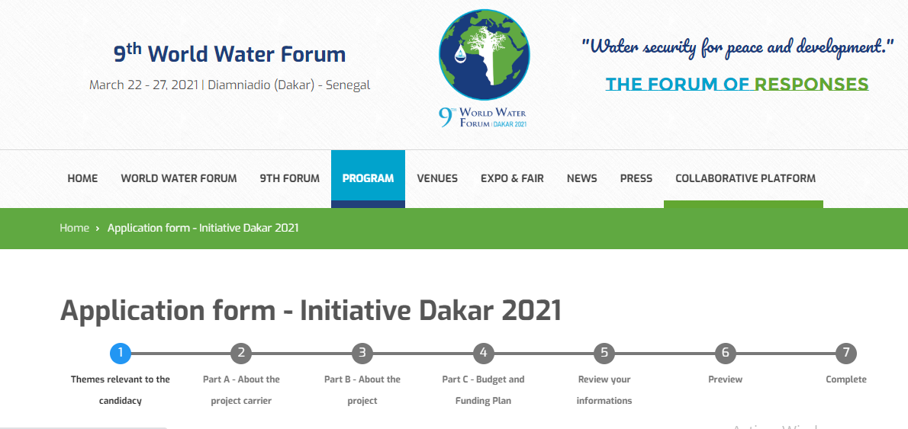
Initiative Dakar 2021
The platform for the submission of applications for the labeling of projects is online since January 2020: https://www.worldwaterforum.org/en/9th-forum/initiative-dakar-2021
So far, projects from 13 countries and 4 continents have been received.
Need to label many projects from the world
TOGETHER WE MAKE WATER A GLOBAL PRIORITY

Slide 10
4- Forum communication

Slide 11
Forum Communication
A strategic plan of communication and marketing actions (national and international) ;
Involvement of the media for information and promotion;
Forum website & social networks;
Newsletter.

Slide 12

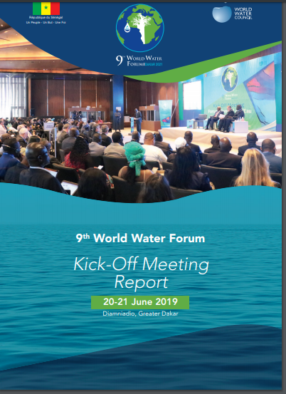
Forum Communication
First announcement of the 9th Forum
Kick-off meeting report

Slide 13


RÉPUBLIQUE DU SÉNÉGAL
Un Peuple – Un But – Une Foi
Thank you for your attention

